Slide 1
BugTrap iteration 2
Group 03
Kwinten Buytaert, Mathias Dekempeneer, Vincent Derkinderen & Ben Goethuys

Slide 2
Contents
General overview
Design choices
Undo
Mailboxes
Milestones
Bugreport states
Testing

Slide 3
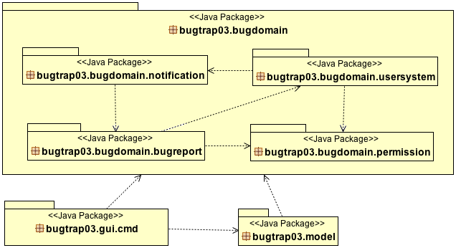
General Overview

Slide 4
Undo

Slide 5
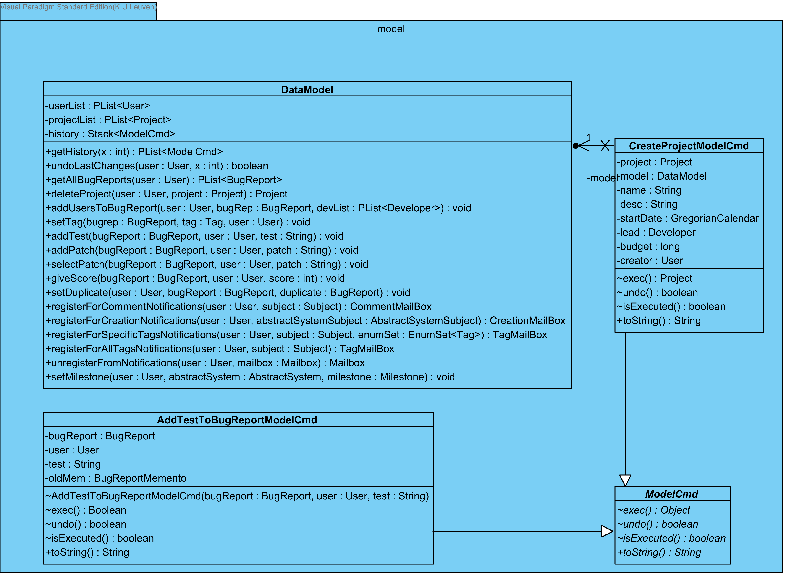
Undo

Slide 6
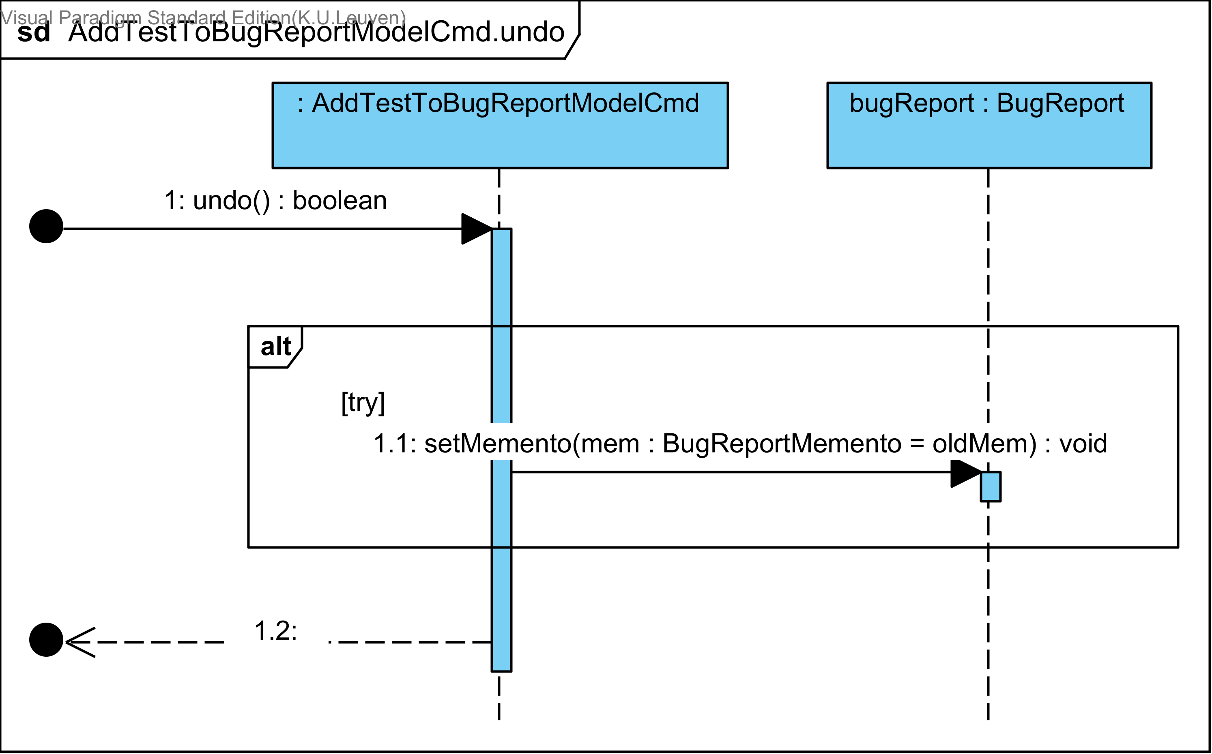
Undo

Slide 7
Notification

Slide 8
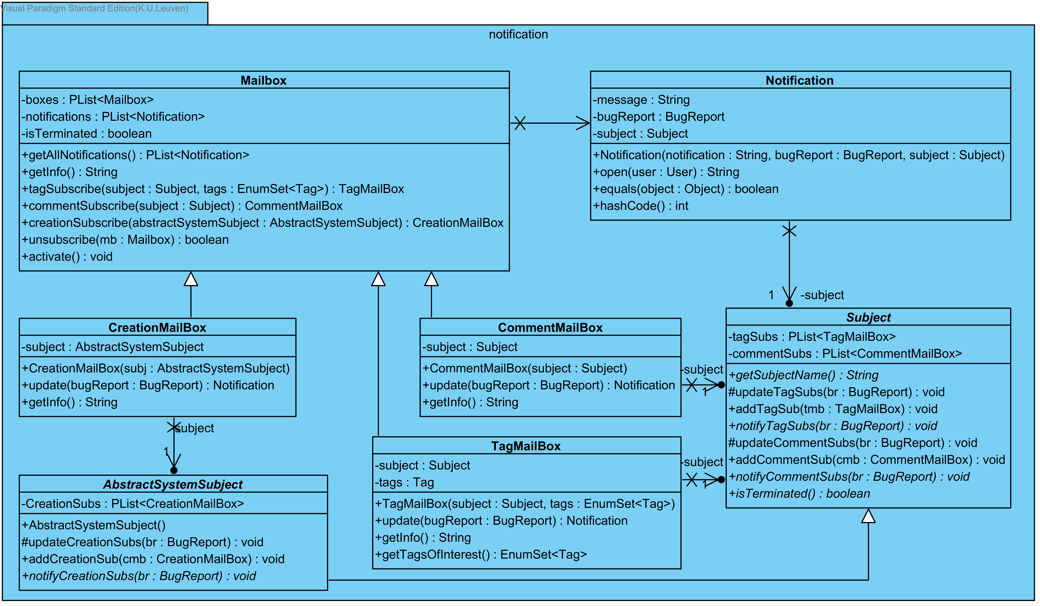
Notification

Slide 9
Milestone

Slide 10
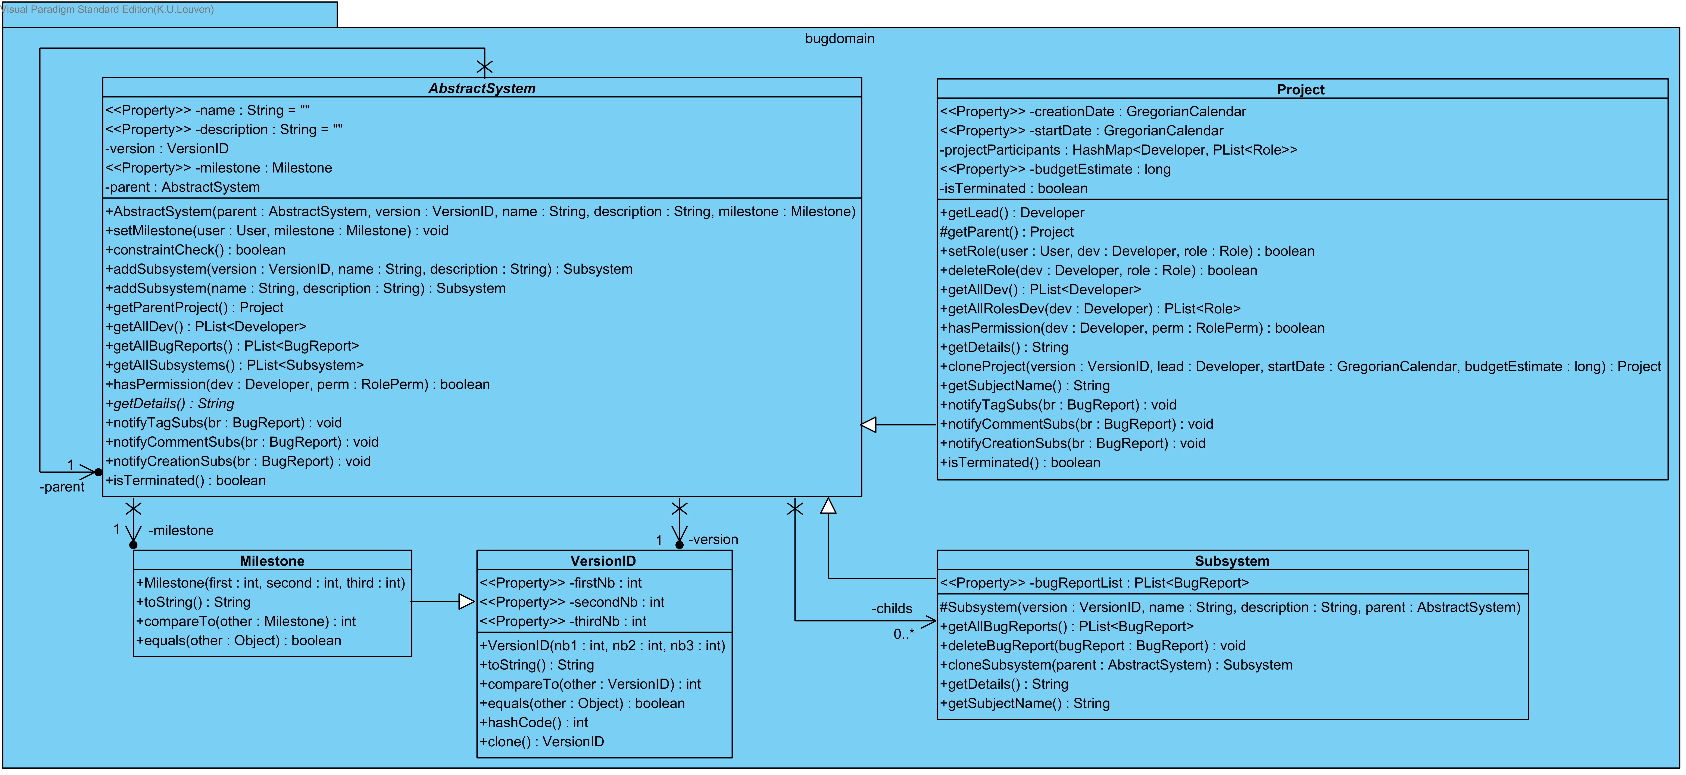
Milestone

Slide 11
BugReport States

Slide 12
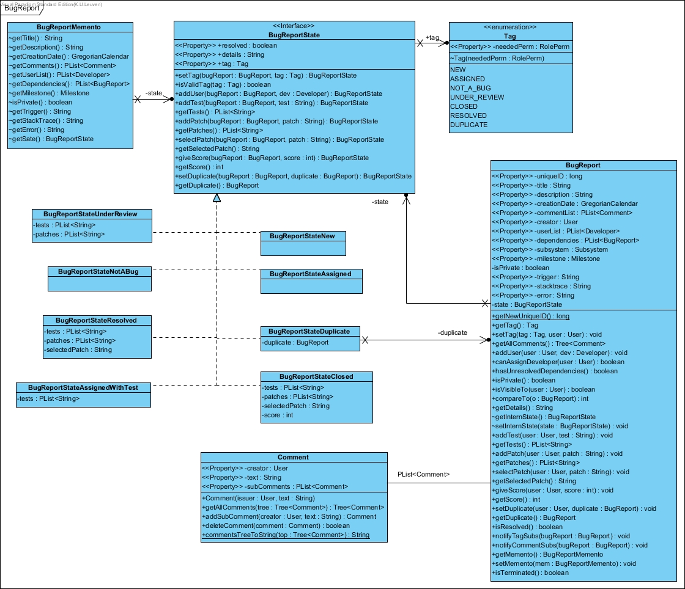
BugReport States

Slide 13
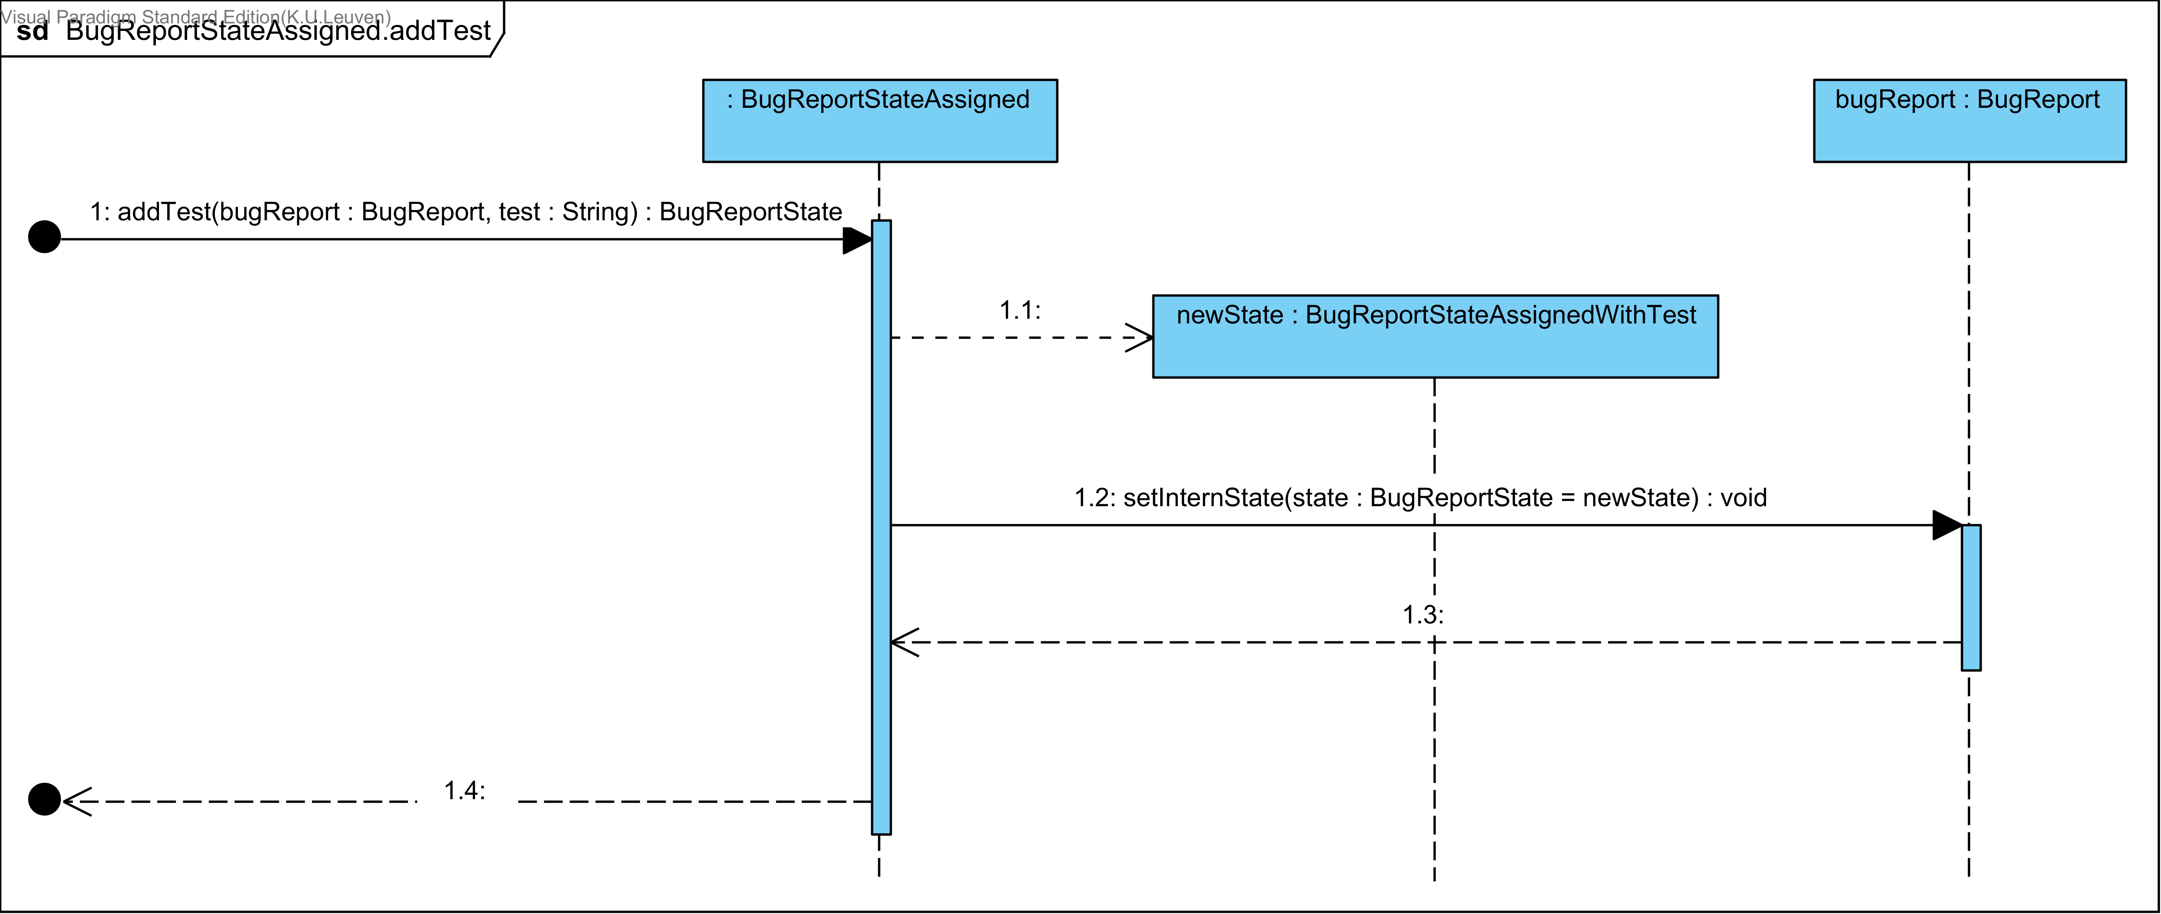
BugReport States

Slide 14
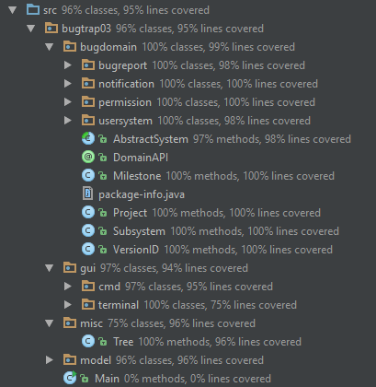
Test Coverage

Slide 15
Roles
Design Coordinator – Kwinten Buytaert
Test Coordinator – Ben Goethuys
Domain Coordinator – Vincent Derkinderen
“Project” Coordinator – Mathias Dekempeneer

Slide 16
Time table
 |  | week 1 | week 2 | week 3 | week 4 | week 5 | week 6 | week 7 | week 8 | week 9 | week 10
studie | ben | 6:00 | 4:35 | 2:00 | 0:00 | 0:00 | 0:30 | 1:00 | 0:00 | 0:00 | 0:00
 | vincent | 6:00 | 5:50 | 1:00 | 0:00 | 0:00 | 0:00 | 0:15 | 0:00 | 0:00 | 0:00
 | mathias | 3:00 | 3:00 | 1:00 | 0:00 | 0:00 | 0:00 | 0:00 | 1:30 | 1:00 | 0:00
 | kwinten | 1:00 | 0:30 | 1:30 | 0:00 | 0:00 | 2:00 | 2:30 | 0:00 | 0:30 | 0:00
code | ben | 0:00 | 4:30 | 21:00 | 13:15 | 4:30 | 7:40 | 5:45 | 11:35 | 10:00 | 6:00
 | vincent | 0:00 | 4:00 | 18:45 | 10:00 | 7:30 | 0:00 | 10:45 | 13:00 | 15:15 | 5:30
 | mathias | 0:00 | 4:00 | 3:00 | 3:00 | 5:30 | 0:00 | 4:00 | 5:00 | 5:00 | 4:00
 | kwinten | 0:00 | 4:00 | 1:00 | 4:15 | 2:15 | 0:00 | 4:00 | 9:00 | 7:00 | 10:00
gemeenschappelijk |  | 0:00 | 11:45 | 8:00 | 9:30 | 14:30 | 9:45 | 7:30 | 0:00 | 0:00 | 15:30
presentatie | ben | 0:00 | 0:00 | 0:00 | 0:00 | 2:45 | 1:30 | 0:00 | 0:00 | 0:00 | 0:00
 | vincent | 0:00 | 0:00 | 0:00 | 0:00 | 2:45 | 1:30 | 0:00 | 0:00 | 0:00 | 0:00
 | mathias | 0:00 | 0:00 | 0:00 | 0:00 | 0:00 | 1:30 | 0:00 | 0:00 | 0:00 | 0:00
 | kwinten | 0:00 | 0:00 | 0:00 | 0:00 | 0:00 | 1:30 | 0:00 | 0:00 | 0:00 | 0:00
hoorcollege | ben | 0:00 | 2:30 | 4:00 | 1:00 | 0:00 | 4:00 | 0:30 | 0:00 | 0:00 | 0:00
 | vincent | 0:00 | 2:30 | 4:00 | 1:00 | 0:00 | 4:00 | 0:30 | 0:00 | 0:00 | 0:00
 | mathias | 0:00 | 2:30 | 4:00 | 1:00 | 0:00 | 4:00 | 0:30 | 0:00 | 0:00 | 0:00
 | kwinten | 0:00 | 2:30 | 2:30 | 1:00 | 0:00 | 4:00 | 0:30 | 0:00 | 0:00 | 0:00
totaal | ben | 6:00 | 23:20 | 35:00 | 23:45 | 21:45 | 23:25 | 14:45 | 11:35 | 10:00 | 21:30
 | vincent | 6:00 | 24:05 | 31:45 | 20:30 | 24:45 | 15:15 | 19:00 | 13:00 | 15:15 | 21:00
 | mathias | 3:00 | 21:15 | 16:00 | 13:30 | 20:00 | 15:15 | 12:00 | 6:30 | 6:00 | 19:30
 | kwinten | 1:00 | 18:45 | 13:00 | 14:45 | 16:45 | 17:15 | 14:30 | 9:00 | 7:30 | 25:30
 |  | 1 | 2 | 3
iteration | ben | 109:50 | 81:15
 | vincent | 107:05 | 83:30
 | mathias | 73:45 | 59:15
 | kwinten | 64:15 | 73:45

